Slide 2
Information retrieval
The efficiency of information services from a database is directly related to its
capability of retrieval of information.

Slide 3
DATABASES AND INFORMATION RETRIEVAL
An Information Retrieval System (IRS)
capable of storage,retrieval and maintenance of information.
consists of a software system that facilitates the user in finding required information.
Efficiency of information services depends largely on the retrieval efficiency of the databases.

Slide 4
Due to some challenges of retrieval of information in repositories, it is necessary to create pointers or keys to actual information in collection.
Indexes are built basically to facilitate search and retrieval.
Indexing is a process of enlisting important terminology and storing them along with location information for each information.
when a user approaches the system with a query the system can look up the list of terminology and display the term that match the query terms along with its location.

Slide 5
An index is a specially stored file in which each entry (record) consists of two values; a data value and a pointer.
The actual database file is organised into records that contain fields and values are entered into these defined fields at the time of data entry.
while the indexed file or the database file is indexed, the index contains terms against which the location is stored like what records contain that term.
That is ‘term’ is the entry against which record ID is stored. Hence the index is referred to as being inverted.

Slide 6
Indexing Methods
Sequential Access
This method is useful when the purpose is akin to browsing (though not exactly)
like in the instance of making a range search.
For example, retrieve records where the value is “not greater than D” and “not less than B”.

Slide 7
Indexing Methods
Direct Access
In the direct access method the index is generated on the values in each field
and can be used to directly retrieve records searching by those values.
For example a query “author = Ranganathan” will yield the records where
Ranganathan is the value in author field.

Slide 8
CONTENT INDEXING
Assignment Indexing
Extraction Indexing

Slide 9
REFERENCE AND INFORMATION ACCESS TOOLS
DOCUMENTARY REFERENCE TOOLS/SOURCES
Dictionaries
Encyclopaedias
Bibliographies
Biographical Sources
Geographical Sources
Ready Reference Sources
Government Publications
Indexing and Abstracting Sources
Patents and Standards
Reference Sources for Current Events

Slide 10
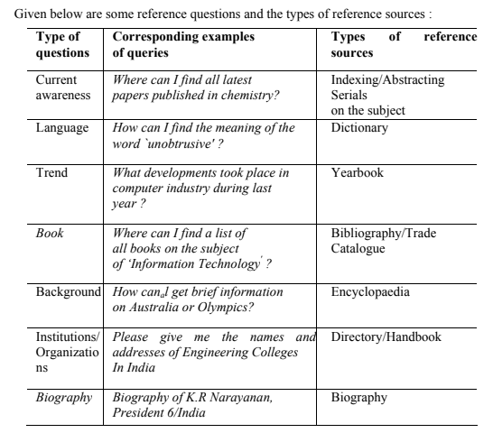

Slide 11
NON-DOCUMENTARY REFERENCE TOOLS/SOURCES
Human resources
Institutional resources
Mass Media
Audio-visual Resource

Slide 12
PURPOSES OF REVIEW OF LITERATURE
A literature review is part of a report.
It provides considerable information on the topic being researched and the various works that had gone on in the field over the years.
These materials are gathered by the researcher from many sources such as journals, books, documents etc.
The review of such a literature could be a matter of fact presentation of the information or it could be a synthesis of a large number of information and put together subject wise for the purpose of understanding.
It can be just a simple summary of the sources, but it usually has an organisational pattern and combines both summary and synthesis.

Slide 13
PURPOSES OF REVIEW OF LITERATURE
In summary all the information is synthesised and given in a capsule form.
It synthesises and organises the entire information in terms of its relevance and appropriateness to the topic of research.
It might give a new interpretation of old material or combine new with old interpretations.
Or it might trace the intellectual progression of the field, including major debates.
And depending on the situation, the literature review may evaluate the sources and advise the reader on the most pertinent and relevant information.

Slide 14
Difference between Literature review and Academic research report
The main focus of an academic research paper is to develop a new argument, a research report will contain the literature review as one of its chapters.
In a research report one uses the literature as a basic foundation and support for newer ideas and insights into the research topic of interest.
Literature review on the other hand summarises and synthesises the many arguments and literature and research findings gathered from such a review and puts forward arguments in favour or against the particular topic and its findings.

Slide 15
Materials to be included in review of literature
Books, journal articles, monographs, documents, grey literature such as unpublished documents or research papers read at some conferences etc.
In addition the internet is an important source from where articles and abstracts could be downloaded for this purpose.
The researcher should organise all the materials according to the year of publication and the subject matter must be organised to give meaning to the entire literature gathered keeping in view the present research topic of interest to the researcher.
The researcher can evaluate these materials on the basis of the methodology used, the research findings arrived etc.

Slide 16
Specific purposes of a Review of the Literature
Identifying variables relevant for research
Avoidance of repetition
Synthesis of prior works
Determining meaning and relationship among variables

Slide 17
Some general purposes of the literature review
To argue for the relevance and the significance of the research question.
To provide the context for one’s own methodological approach
To establish one’s own credibility as a knowledgeable and capable researcher.
To argue for the relevance and appropriateness of one’s own approach.

Slide 18
SOURCES OF THE REVIEW OF LITERATURE
Journals and Books
Reviews
Abstracts
Indexes
Internet
Doctoral Dissertations
Supervisors/ Research professors

Slide 19
WRITING PROCESS OF THE REVIEW OF LITERATURE
Find a focus
Do they present one or different solutions?
Is there an aspect of the field that is missing?
How well do they present the material ?
Do they portray it according to an appropriate theory?
Do they reveal a trend in the field?
A raging debate?

Slide 20
Construct a working thesis statement
The thesis statement should argue for a particular perspective on the material.
Consider organisation
Once the statement has been made,
what is the most effective way of presenting the information?
What are the most important topics, subtopics, etc., that the review needs to include?
And in what order should they be presented?
The researcher should develop an organisation for the review at both a global and local level

Slide 21
Cover the basic categories
Just like most academic papers, literature reviews also must contain at least three
basic elements:
an introduction or background information section;
the body of the review containing the discussion of sources;
finally, a conclusion and/or recommendations section to end the paper.

Slide 22
Organise the body of the report
Chronological Method
Method By publication
Method By trend

Slide 23
Add additional sections
Current situation
History
Methods and/or standards
Questions for further research

Slide 24
Steps for writing a good literature review
Relevant reviews
Write critical annotations while going through the various reviews
To develop a structure
To write purposefully
Use the literature to support the argument
Make the literature review an ongoing process
Get plenty of feedback
Remain prepared for redrafting

Slide 25
INDEXING AND ABSTRACTING
Indexing and abstracting periodicals are called secondary publications.
They are the access tools to already published primary documents such as, articles/papers in newspapers and periodicals, research papers, reports, patents, conference proceedings and so on.

Slide 26
DEFINITION, FUNCTIONS AND NEED

Slide 27
Definition
The word `index' is derived from the Latin word `indicare' meaning `to point out' or`to show'.
An indexing periodical is an access tool to a systematically arranged list of periodical literature providing complete bibliographical references of already published individual items of primary documents, which a republished in regular interval.
It is organised in a convenient manner to search the location of entries.
An Index can be alphabetical, classified, chronological, geographical or numerical.
They are access tools to identify and locate the required information which appeared in a particular periodical,

Slide 28
Definition
An `abstract' according to ALA Glossary (1983) is `an abbreviated, accurate representation of a work, usually without added interpretation or criticism, accompanied by a bibliographical reference to the original work when appearing separately from it'.
An abstracting periodical, in addition to having the above mentioned features of an indexing periodical, gives the information content of the primary documents in a condensed form.

Slide 29
The major difference between indexing and abstracting services lies in the form and content.
Indexing periodicals provide lists of articles with bibliographical details arranged in user-friendly order to enable a user to trace the needed information easily and quickly.
Abstracting periodicals not only list the bibliographical details but also provide abstracts of documents in a specific field or a group of subject fields helping the reader for his choice of an article or a paper.

Slide 30
Functions
The primary functions of indexing and abstracting periodicals are:
to keep scholars and information users abreast of current literature in their fields of interest. They can be benefited from scanning the issues of indexing and abstracting periodicals. This can be termed as current use function;
to find information on the literature of the subject fields as and when need arises. The indexing and abstracting periodicals are key tools to librarians and information workers for day to day reference and bibliographical work, though research scholars also use them extensively. This can be termed as retrospective search function;
and to provide bibliographical control of literature output either by country or by subject or by kind of materials, if the aim of the indexing and abstracting services is exhaustive coverage. This can be termed as comprehensive use function.

Slide 31
The secondary functions are:
to obtain correct and complete bibliographical details of particular items of literature, when there is any doubt;
to look up for information on a topic, which may not have been well covered by books, encyclopaedias, etc.;
to make known the work of individual scientists or scholars;
to serve as a source for carrying out statistical, bibliometric and sociological studies on the growth and pattern of literature, indicative of research and development efforts taking place; and
to help users to get information which is otherwise scattered in other sources.

Slide 32
Needs
The I & A periodicals are convenient tools to provide scholars a bird's eye view of literature of their specific interest easily and quickly.
They cover information from vast volume of primary literature scattered in a numerous sources in fewer pages.
The abstracting periodicals help users in further reducing the effort of scanning by giving an idea of the information content of documents and its relevance to the purpose.
The I & A periodicals also fulfil the requirements of scholar who needs to scan information from the earlier literature on the subject for a problem undertaken for study or research.

Slide 33
Qualities
Coverage
Time lag
Indexes
The Bibliographic description
Ease in Consultation

Slide 34
Scope and presentation??

Slide 35
Citation Indexes
Citation indexes are unique from the point of view of technique followed.
They are based on citations made in current documents.
They follow a novel method of detecting subject relationship of documents through citations, and are claimed to be a useful tool for subject retrieval.
The fact of the association through citation is transformed into an index keeping the direction from cited to citing documents.

Slide 36
Examples
Science Citation Index
The SCI comprises several parts like citation index, source index, the
permuterm subject index and the corporate index.
Science Citation Index with Abstracts
Science Citation Index -Journal Citation Reports (JCR)

Slide 37
Examples
Social Sciences Citation Index (SSCI)
Social Sciences Citation Index with Abstract
Social Sciences Citation Index-Journal Citation Reports JCR
Arts and Humanities Citation Index.

Slide 38
Journal Citation Report
The JCRs of the Citation Indexes offer a systematic and objective means of
determining the relative importance of journals with regards to –
• how frequently a journal has been cited;
• by which journals, a journal has been cited;
• how soon after publication and for how long a journal has been cited; and
• which journals are cited by a particular journal.

Slide 39
Current content
Coverage by geographical area
Coverage by specific subject
Coverage by kind of documents

Slide 40
Bibliography

Slide 41
Critical review

Slide 42
Definition
A critical review of a journal article evaluates the strengths and weaknesses of an article's ideas and content.
It provides description, analysis and interpretation that allow readers to assess the article's value.
A critical review (sometimes called a critique, critical commentary, critical appraisal, critical analysis) is a detailed commentary on and critical evaluation of a text.

Slide 43
Critical and evaluation
To be critical does not mean to criticise in an exclusively negative manner.
To be critical of a text means you question the information and opinions in the text, in an attempt to evaluate or judge its worth overall.
An evaluation is an assessment of the strengths and weaknesses of a text. This should relate to specific criteria, in the case of a research article.
You have to understand the purpose of each section, and be aware of the type of information and evidence that are needed to make it convincing, before you can judge its overall value to the research article as a whole.

Slide 44
Difference between a Literature Review and a Critical Review
A literature review is a type of critical review in which you analyze and evaluate many sources on a specific topic.
The purpose is to provide your reader with an overview of the research that has been done on your topic, and to evaluate the sources you are reviewing.
You will probably include less detailed information on each source than you would in a critical review of a single book or article.
Instead, you will focus on the most important points relevant to your topic.

Slide 45
Difference between a Literature Review and a Critical Review
As in a critical review, you’ll evaluate the effectiveness of the authors’ arguments.
You’ll also point out areas where much research has been done, as well as areas where more research still needs to be done.
It’s also important to compare sources with each other, pointing out where they agree or disagree with one another.
Remember, you also need to provide an evaluation explaining which authors’ writing you find more persuasive, and why.

Slide 46
Writing Critical Reviews
Before You Read the Article
What does the title lead you to expect about the article?
Study any sub-headings to understand how the author organized the content.
Read the abstract for a summary of the author's arguments.
Study the list of references to determine what research contributed to the author's arguments. Are the references recent? Do they represent important work in the field?
If possible, read about the author to learn what authority he or she has to write about the subject.
Consult Web of Science to see if other writers have cited the author's work. Has the author made an important contribution to the field of study?

Slide 47
Writing Critical Reviews
Reading the Article: Points to Consider
Who is the intended audience?
What is the author's purpose? To survey and summarize research on a topic? To present an argument that builds on past research? To refute another writer's argument?
Does the author define important terms?
Is the information in the article fact or opinion? (Facts can be verified, while opinions arise from interpretations of facts.) Does the information seem well-researched or is it unsupported?
What are the author's central arguments or conclusions? Are they clearly stated? Are they supported by evidence and analysis?
If the article reports on an experiment or study, does the author clearly outline methodology and the expected result?
Is the article lacking information or argumentation that you expected to find?
Is the article organized logically and easy to follow?
Does the writer's style suit the intended audience? Is the style stilted or unnecessarily complicated?
Is the author's language objective or charged with emotion and bias?
If illustrations or charts are used, are they effective in presenting information?

Slide 48
Prepare an Outline
Read over your notes.
Choose a statement that expresses the central purpose or thesis of your review.
When thinking of a thesis, consider the author's intentions and whether or not you think those intentions were successfully realized.
Eliminate all notes that do not relate to your thesis.
Organize your remaining points into separate groups such as points about structure, style, or argument.
Devise a logical sequence for presenting these ideas.
Remember that all of your ideas must support your central thesis.

Slide 49
Write the First Draft
The review should begin with a complete citation of the article.
The first paragraph may contain:
a statement of your thesis
the author's purpose in writing the article
comments on how the article relates to other work on the same subject
information about the author's reputation or authority in the field

Slide 50
Write the First Draft
The body of the review should:
state your arguments in support of your thesis
follow the logical development of ideas that you mapped out in your outline
include quotations from the article which illustrate your main ideas
The concluding paragraph may:
summarize your review
restate your thesis

Slide 51
Revise the First Draft
Check for the following when revising:
grammar and punctuation errors
organization, logical development and solid support of your thesis
errors in quotations or in references

Slide 52
How to Write Critical Reviews
Understanding the Assignment
Write the introduction
Introduce your review appropriately
Explain relationships
Provide an overview
Write the body
Organize using a logical plan
Questions to keep in mind as you write (next slide)
Keep your opinions distinct and cite your sources
Write the conclusion

Slide 53
Questions to keep in mind as you write
What are the author’s most important points? How do these relate to one another?
What types of evidence or information does the author present to support his or her points? Is this evidence convincing, controversial, factual, one-sided, etc.?
Where does the author do a good job of conveying factual material as well as personal perspective? Where does the author fail to do so? If solutions to a problem are offered, are they believable, misguided, or promising?
Which parts of the work (particular arguments, descriptions, chapters, etc.) are most effective and which parts are least effective? Why?
Where (if at all) does the author convey personal prejudice, support illogical relationships, or present evidence out of its appropriate context?

Slide 54
Consider the following questions while writing conclusion
Is the work appropriately subjective or objective according to the author’s purpose?
How well does the work maintain its stated or implied focus?
Does the author present extraneous material? Does the author exclude or ignore relevant information?
How well has the author achieved the overall purpose of the book or article?
What contribution does the work make to an existing body of knowledge or to a specific group of readers? Can you justify the use of this work in a particular course?
What is the most important final comment you wish to make about the book or article?
Do you have any suggestions for the direction of future research in the area? What has reading this work done for you or demonstrated to you?

Slide 55
Research gap
A research gap is, simply, a topic or area for which missing or insufficient information limits the ability to reach a conclusion for a question.
It should not be confused with a research question

Slide 56
How to Identify Research Gap?
Identify your key motivating issue/question
Identify key terms associated with this issue
Review the literature, searching for these key terms and identifying relevant publications
Review the literature cited by the key publications which you located in the above step
Identify issues not addressed by the literature relating to your critical motivating issue

Slide 57
Challenges while identifying research gaps
1. Effort of dealing with an enormous amount of information
2. Difficulty of searching in an organized manner
3. Hesitation in questioning established norms

Slide 58
Different Types of Research Gaps
1. Knowledge gaps
2. Conceptual gaps
3. Methodological gaps
4. Data gaps
5. Practical gaps

Slide 59
1. Knowledge gaps
These are gaps in knowledge or understanding of a subject, where more research is needed to fill the gaps.
For example, there may be a lack of understanding of the mechanisms behind a particular disease or how a specific technology works.

Slide 60
2. Conceptual gaps
These are gaps in the conceptual framework or theoretical understanding of a subject. For example, there may be a need for more research to understand the relationship between two concepts or to refine a theoretical framework.

Slide 61
3. Methodological gaps
These are gaps in the methods used to study a particular subject. For example, there may be a need for more research to develop new research methods or to refine existing methods to address specific research questions.

Slide 62
4. Data gaps
These are gaps in the data available on a particular subject. For example, there may be a need for more research to collect data on a specific population or to develop new measures to collect data on a particular construct.

Slide 63
5. Practical gaps
These are gaps in the application of research findings to practical situations. For example, there may be a need for more research to understand how to implement evidence-based practices in real-world settings or to identify barriers to implementing such practices.

Slide 64
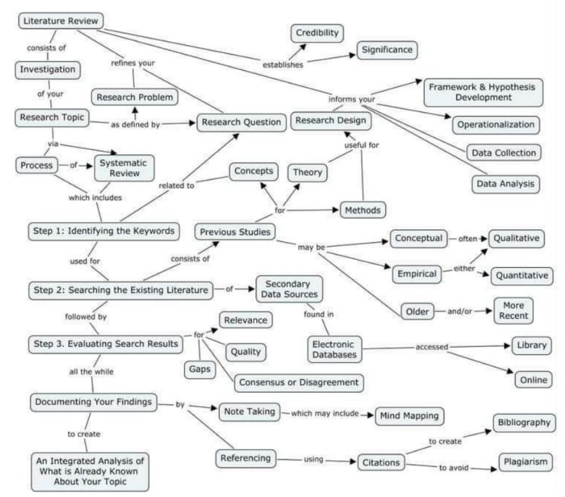

Slide 65
Evidence Gap;
Knowledge Gap;
Practical-Knowledge Conflict Gap;
Methodological Gap;
Empirical Gap;
Theoretical Gap;
Population Gap.

Slide 66
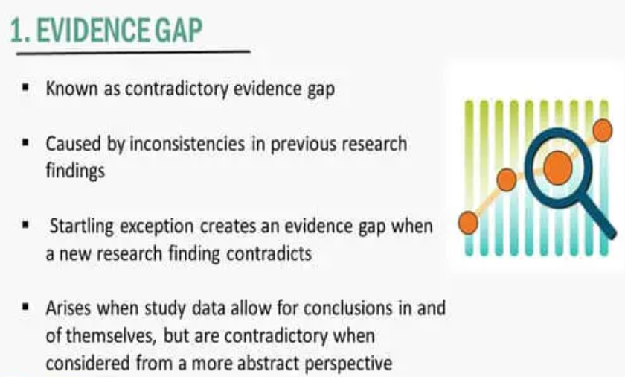
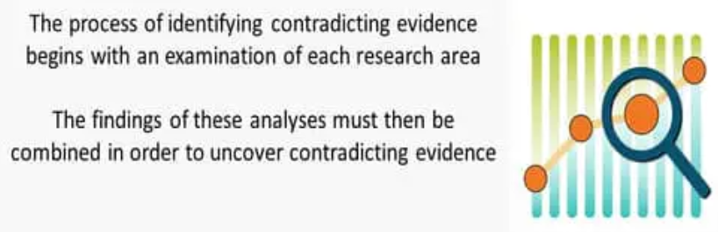

Slide 67
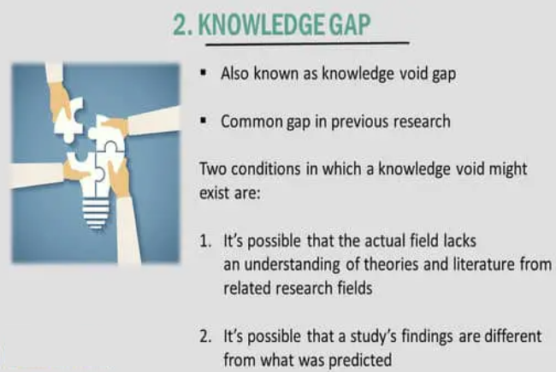

Slide 68
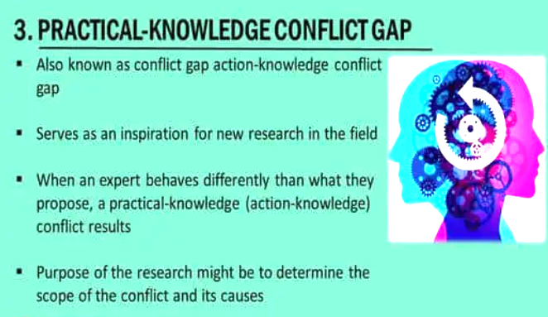

Slide 69
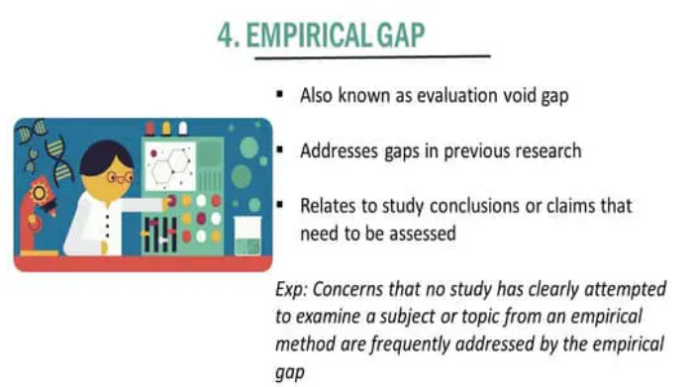

Slide 70
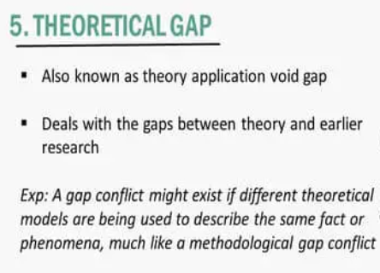
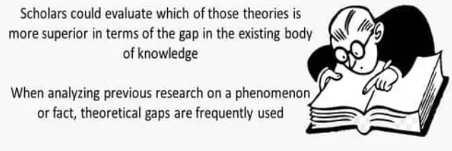

Slide 71
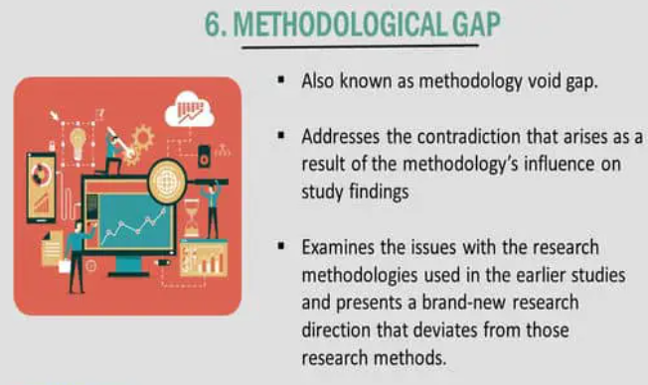
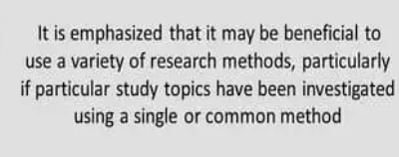

Slide 72
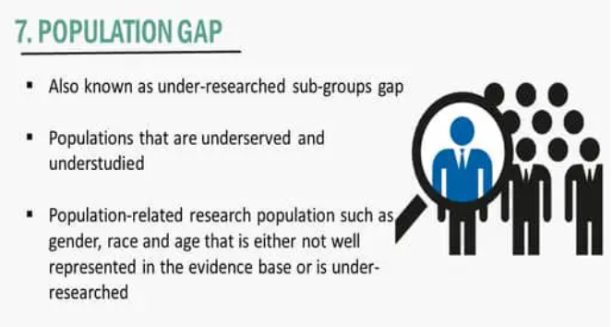

Slide 73
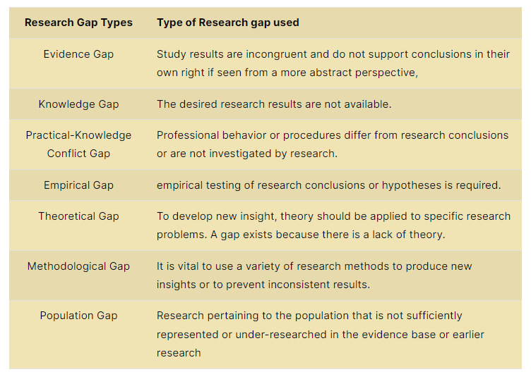

Slide 74
Conceptualizing and operationalizing (and sometimes hypothesizing)

Slide 75
Concepts are constructs; they represent the agreed on meanings we assign to terms.
Our concepts don’t exist in the real world, so they cannot be measured directly, but we can measure the things our concepts summarize.
In research, conceptualization produces an agreed upon meaning for a concept for the purposes of research.
Different researchers may conceptualize a concept slightly differently.
Conceptualization describes the indicators we'll use to measure the concept and the different aspects of the concept.

Slide 76
Conceptualization
Providing a very precise definition of the topics or concepts being investigated. Developing a "working definition."
It is so important that we come up with a "working definition" of the concepts we are investigating.
1. Helps us focus on what we are really studying. Guides how we investigate what we are studying.
2. Also lets others know what exactly it is we are studying.

Slide 77
The key thing to remember about conceptualization, is that it is very abstract process. That is, definitions produced are conceptual in nature.

Slide 78
operationalization
Operationalization is the development of specific research procedures that will result in empirical observations representing the concepts.

Slide 79
Operationalization
Process of coming up with a concrete, practical definition of how a concept will be observed.
Spell out exactly how the topic be observed. Specify the exact procedures that will be carried out when observing a variable or concept.
Specify precisely all of the steps involved in observing the topic.
Identify what will count and what won’t count.

Slide 80
Issues
Range of variation: the limits of your attributes
Examples: age, income
Variations between the Extremes
How many attributes to have between the extremes

Slide 81
Operationalization contd.,
General Issues to Address
1. Capturing range of variation
Human behavior and characteristics vary from one extreme to another. Do the procedures you are proposing allow you to observe the entire range of behavior?
2. Degree of precision
Now that you have decided the range of behavior that your procedures are going to allow you to observe -- you need to decide how precise your observations need to be.

Slide 82
3. Reliability
How reliable are the procedures we employ?
When we employ the same procedures on the same individual or unit under investigation, will we get the same answer?
4. Validity
How valid are our procedures? How well do our operational procedures mesh with our conceptual definitions?

Slide 83
Two important qualities of all variables
Exhaustive
 You should be able to classify every observation into one attribute.
 Mutually exclusive
 You must be able to classify each observation into one and only one attribute.

Slide 84
Four Levels of Measurement
Nominal measures
Ordinal measures
Interval measures
Ratio measures

Slide 85
Nominal: the data can only be categorized
Ordinal: the data can be categorized and ranked
Interval: the data can be categorized, ranked, and evenly spaced
Ratio: the data can be categorized, ranked, evenly spaced, and has a natural zero.

Slide 86
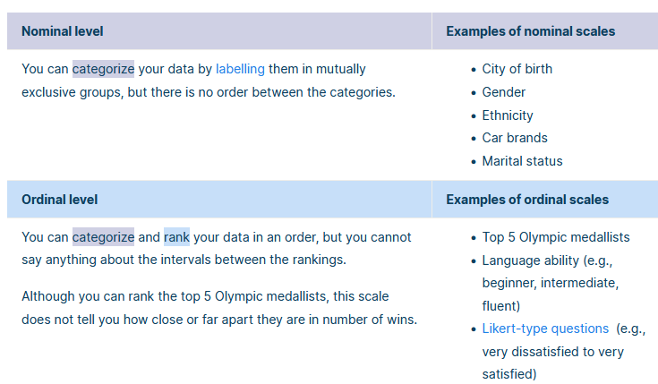

Slide 87
